Slide 1

Time Intelligence Dax function
Shruthi

Slide 2

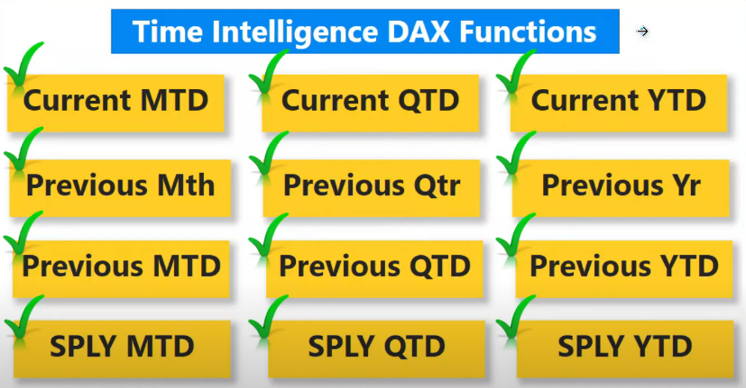

Slide 3

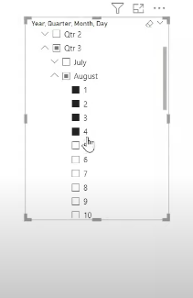
Current MTD
Background how it works:
Current MTD = CALCULATE(TOTALMTD([Total_sales],DATESMTD(Orders[Order_date ])))
Note:
Total_sales = sum(Orders[Sales])

Slide 4
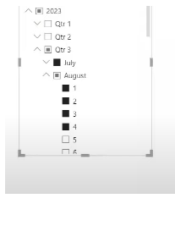
Current QTD
Background how it works:
Current QTD = CALCULATE(TOTALQTD([Total_sales],DATESQTD(Orders[Order_date ])))
Note:
Total_sales = sum(Orders[Sales])

Slide 5
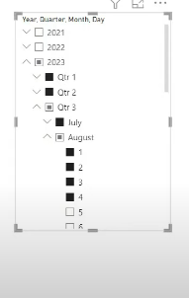
Current YTD
Background how it works:
Current YTD = CALCULATE(TOTALYTD([Total_sales],DATESYTD(Orders[Order_date ])))
Note:
Total_sales = sum(Orders[Sales])

Slide 6
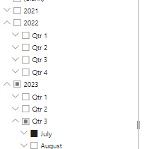
Previous Mth
Background how it works:
Previous Month Total sales = CALCULATE([Total_sales], PREVIOUSMONTH(DATESMTD(Orders[Order_date ])))
Note:
Total_sales = sum(Orders[Sales])

Slide 7
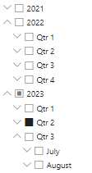
Previous Qtr
Background how it works:
Previous Qtr Total sales = CALCULATE([Total_sales], PREVIOUSQUARTER(DATESQTD(Orders[Order_date ])))
Note:
Total_sales = sum(Orders[Sales])

Slide 8
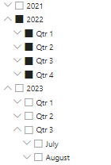
Previous Yr
Background how it works:
Previous Year Total sales = CALCULATE([Total_sales], PREVIOUSYEAR(DATESYTD(Orders[Order_date ])))
Note:
Total_sales = sum(Orders[Sales])

Slide 9
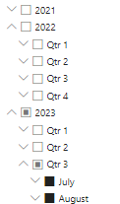
Previous MTD
Background how it works:
previous MTD = ([Previous Month Total sales]+[Current MTD])

Slide 10
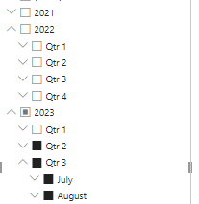
Previous QTD
Background how it works:
Previous QTD = ([Previous Qtr Total sales]+[Current QTD])

Slide 11
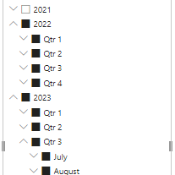
Previous YTD
Background how it works:
Previous YTD =
([Previous Year Total sales] + [Current YTD])

Slide 12
SPLY MTD
SPLY MTD = CALCULATE([Current MTD], SAMEPERIODLASTYEAR(Orders[Order_date ]))

Slide 13
SPLY YTD
SPLY YTD = CALCULATE([Current YTD], SAMEPERIODLASTYEAR(Orders[Order_date ]))

Slide 14
SPLY QTD
SPLY QTD = CALCULATE([Current QTD], SAMEPERIODLASTYEAR(Orders[Order_date ]))

Slide 15
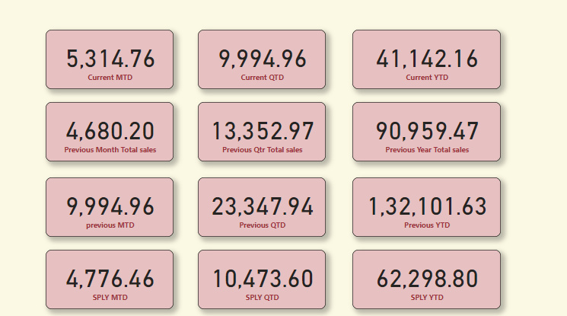
Dashboard:

Slide 16
Thank You

